Slide 1

Ultrasonic vibrations in metallurgy…
www.UltrasonicMetallurgy.com
…Trials in water…
MP Interconsulting
Marais 36,
2400 Le Locle, Switzerland
www.UltrasonicsWorldGroup.com
Phone: +41-32-9314045
Fax: +41-32-9314079
www.mpi-ultrasonics.com
mpi@mpi-ultrasonics.com

Slide 2
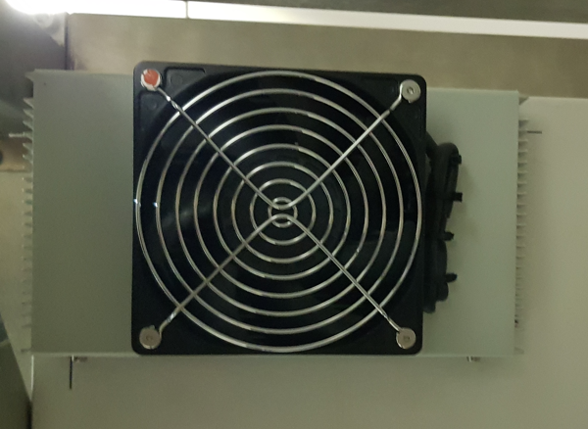
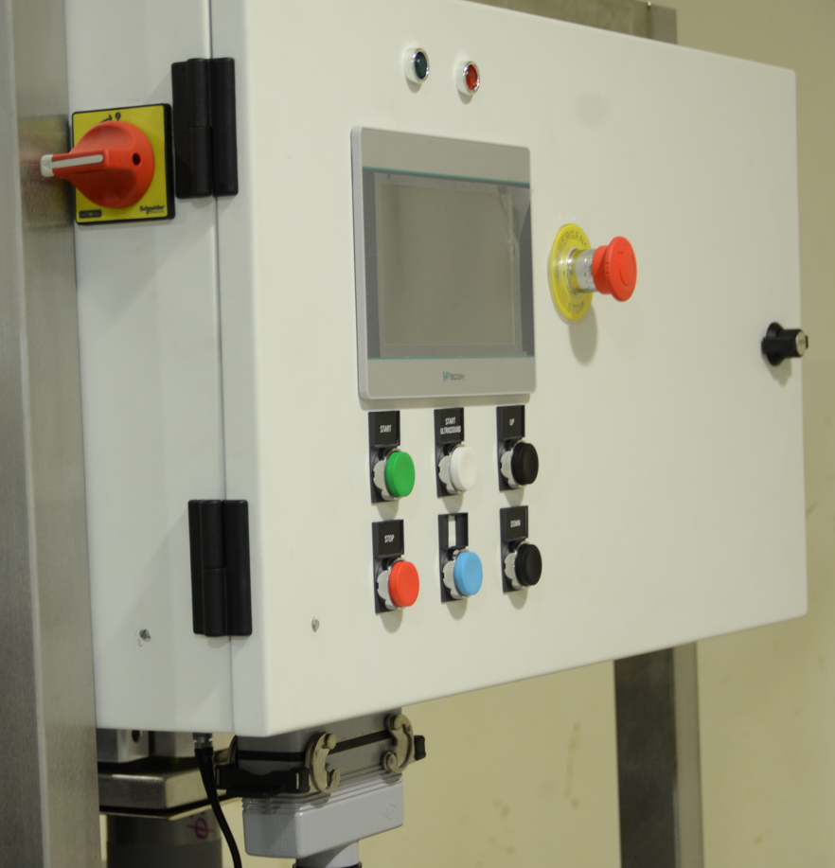
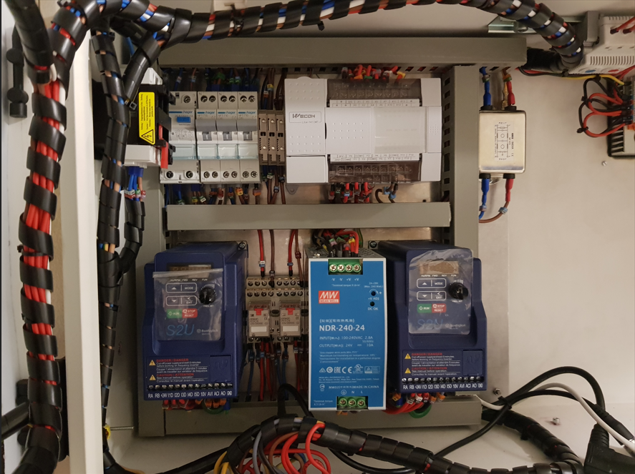
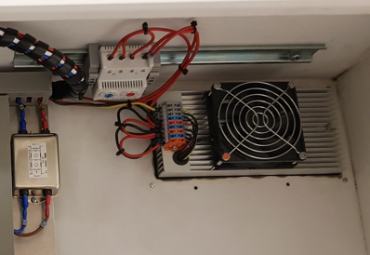
Ultrasonic Device for Melt Treatment
1. Electrical Control
Temperature Control
Cooling Eletrical “box” – Peltier [EPDC – 50 – A]
2021 ® MP Interconsulting || Marais 36, 2400 Le Locle, Switzerland ||www.UltrasonicsWorldGroup.com || mpi@mpi-ultrasonics.com

Slide 3
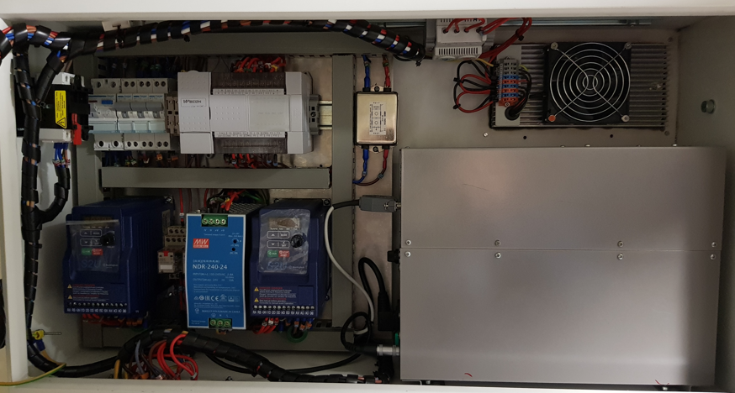
Ultrasonic Device for Melt Treatment
1. Electrical Control
PLC [CLP Wecon LX3V 2416 MR]
US Generator
2021 ® MP Interconsulting || Marais 36, 2400 Le Locle, Switzerland ||www.UltrasonicsWorldGroup.com || mpi@mpi-ultrasonics.com

Slide 4
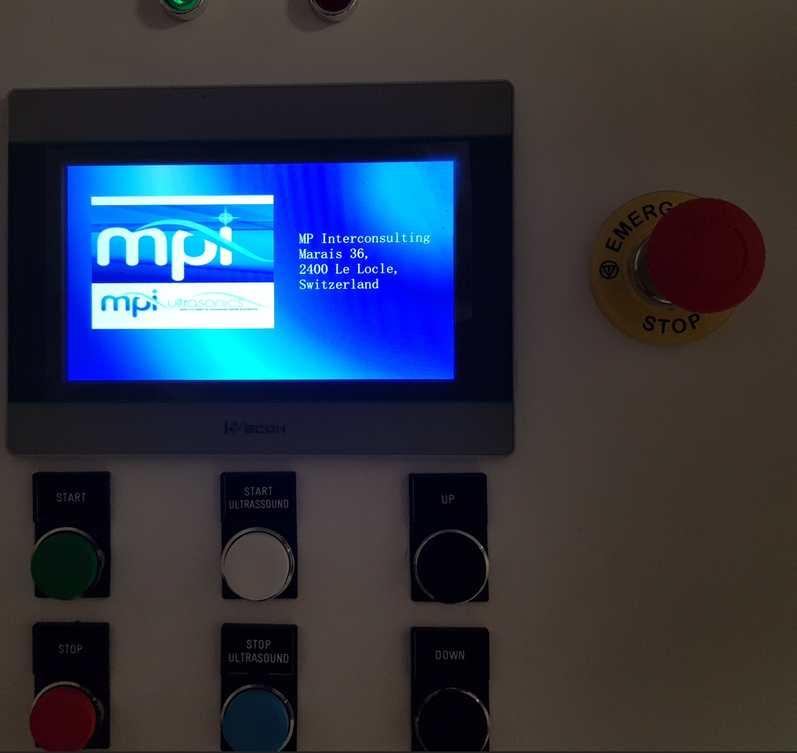
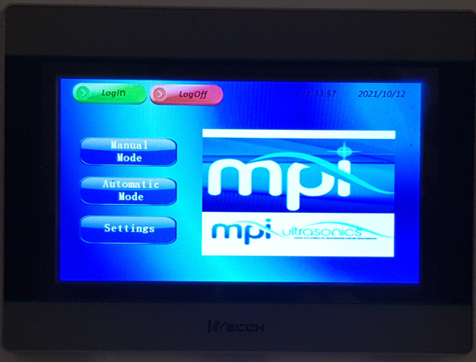
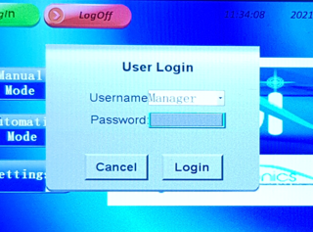
Ultrasonic Device for Melt Treatment
2. HDMI working…
2021 ® MP Interconsulting || Marais 36, 2400 Le Locle, Switzerland ||www.UltrasonicsWorldGroup.com || mpi@mpi-ultrasonics.com

Slide 5
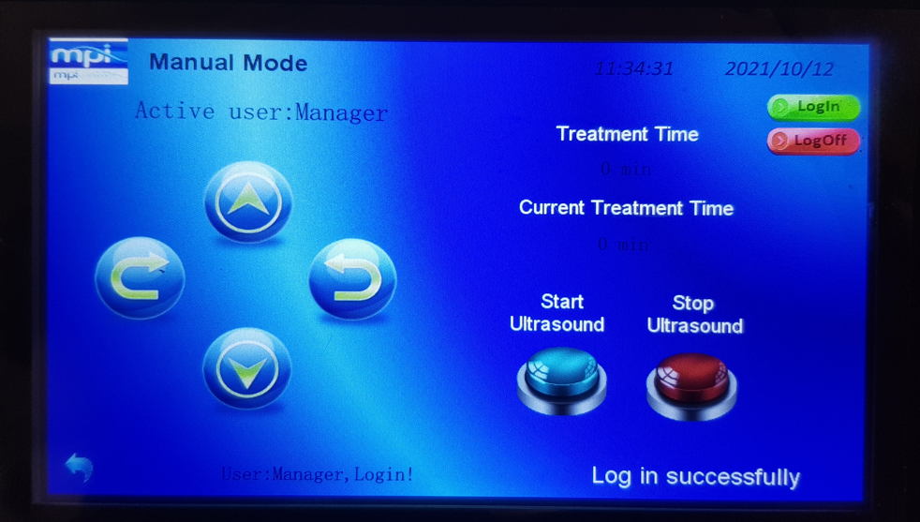
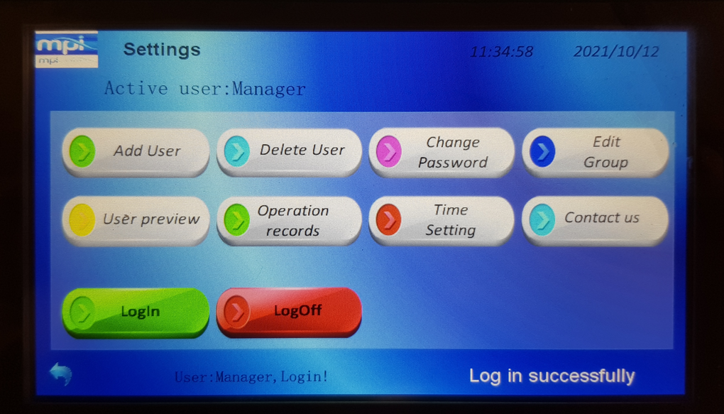
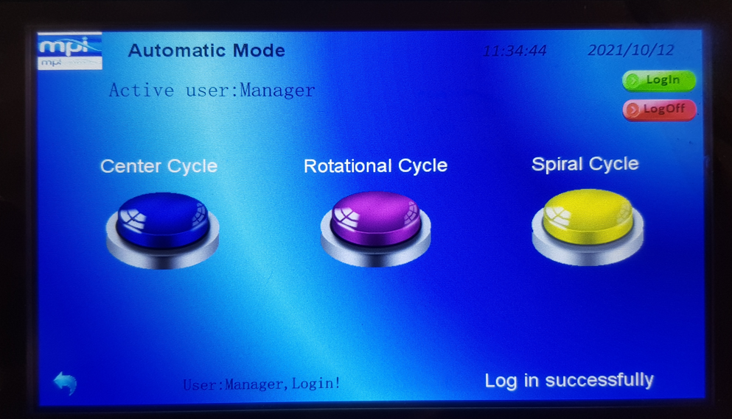
Ultrasonic Device for Melt Treatment
2. HDMI working…
2021 ® MP Interconsulting || Marais 36, 2400 Le Locle, Switzerland ||www.UltrasonicsWorldGroup.com || mpi@mpi-ultrasonics.com

Slide 6
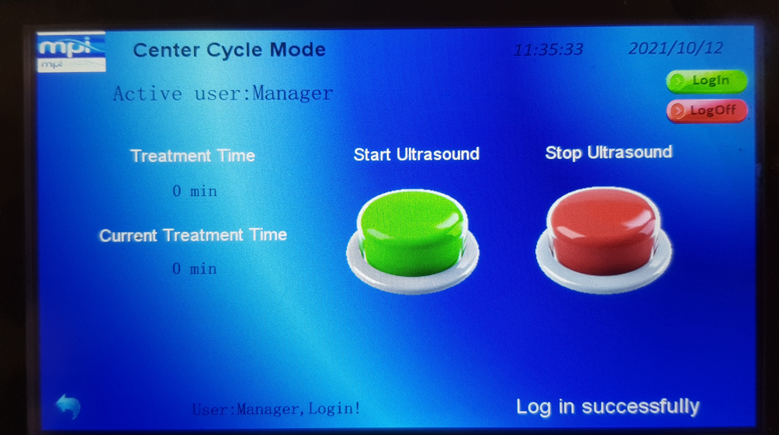
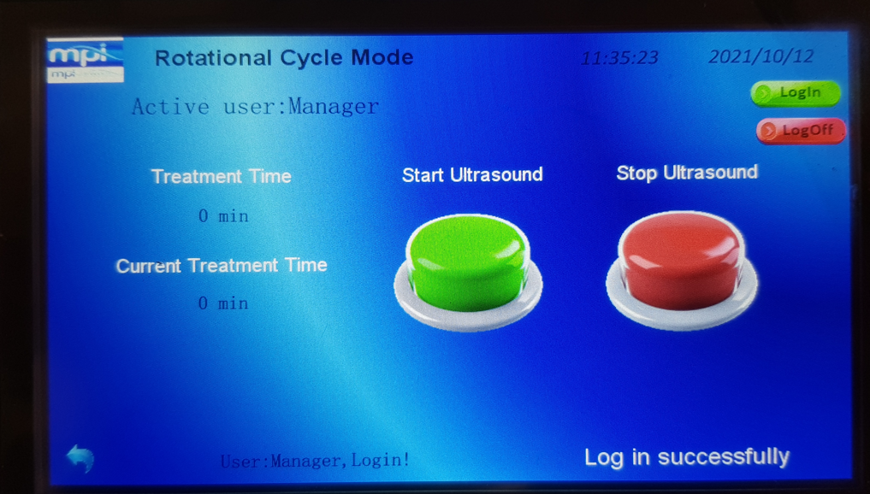
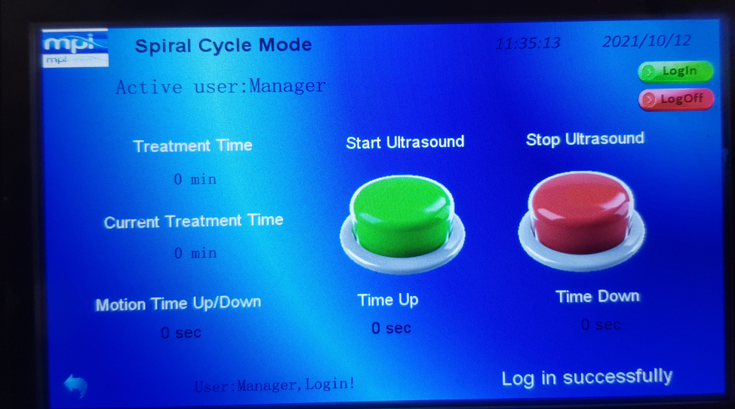
Ultrasonic Device for Melt Treatment
2. HDMI working…
2021 ® MP Interconsulting || Marais 36, 2400 Le Locle, Switzerland ||www.UltrasonicsWorldGroup.com || mpi@mpi-ultrasonics.com

Slide 7
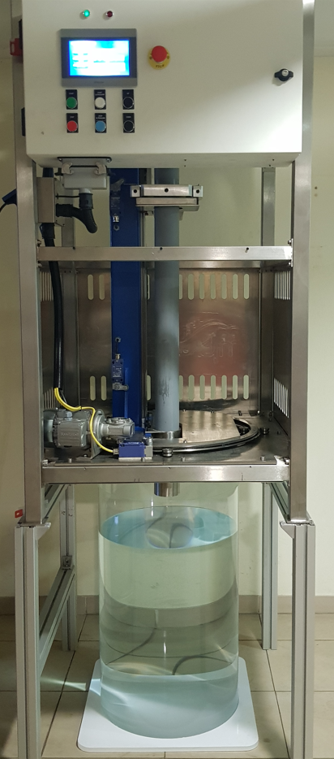
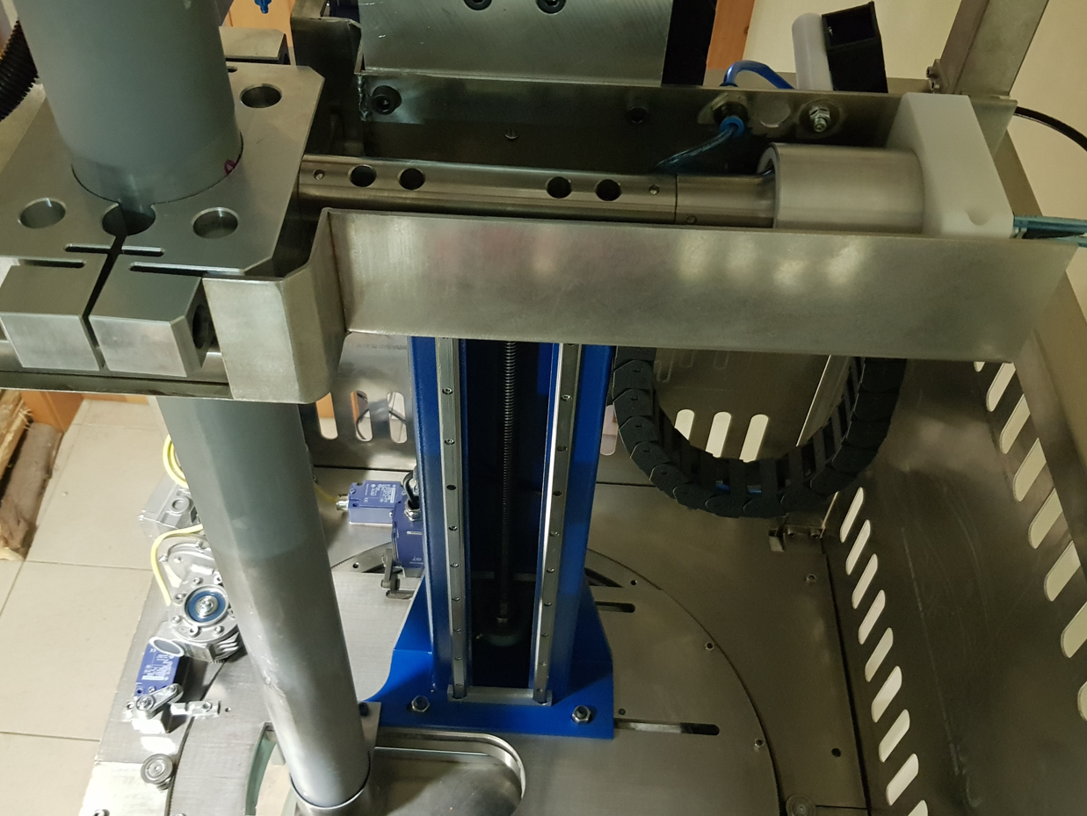
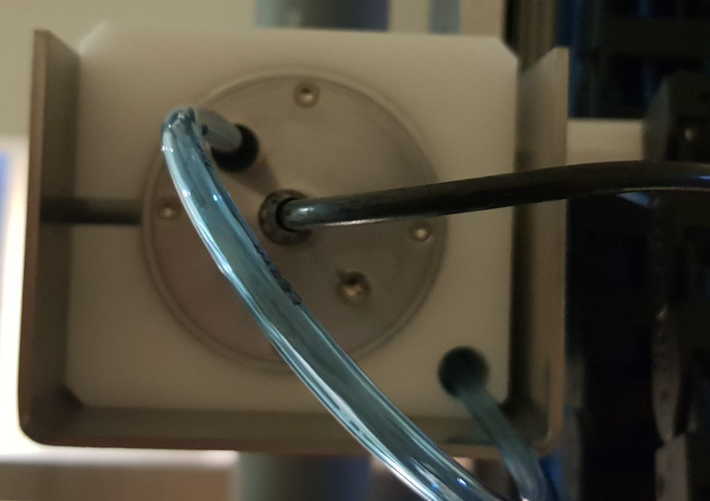
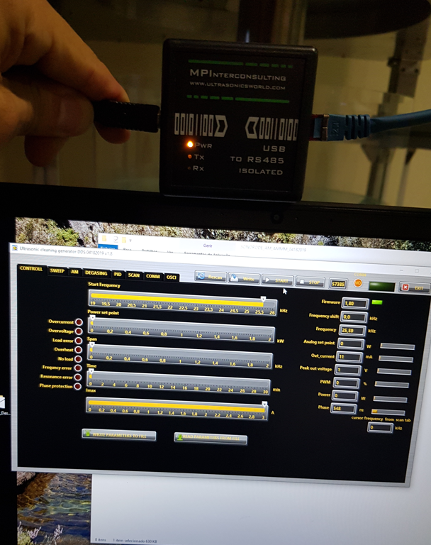
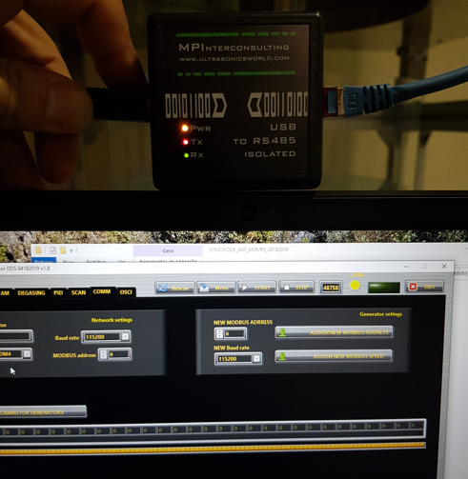
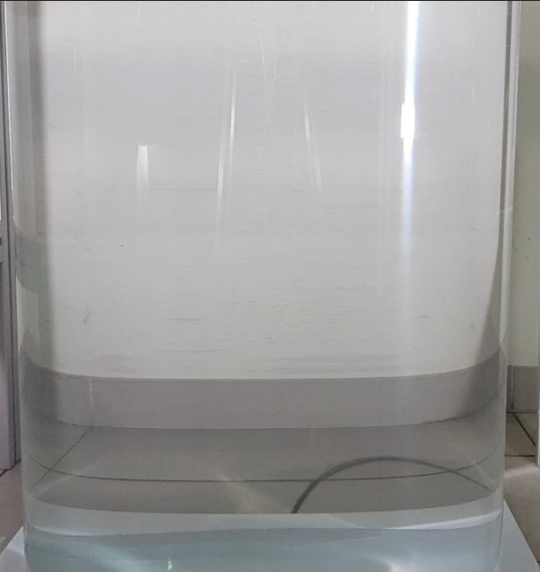
Ultrasonic Device for Melt Treatment
3. Trials
H. 700 mm
water
Diam. 500 mm
2021 ® MP Interconsulting || Marais 36, 2400 Le Locle, Switzerland ||www.UltrasonicsWorldGroup.com || mpi@mpi-ultrasonics.com

Slide 8
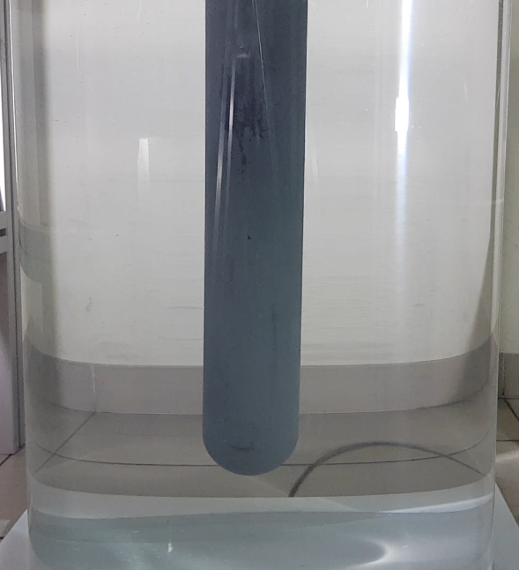
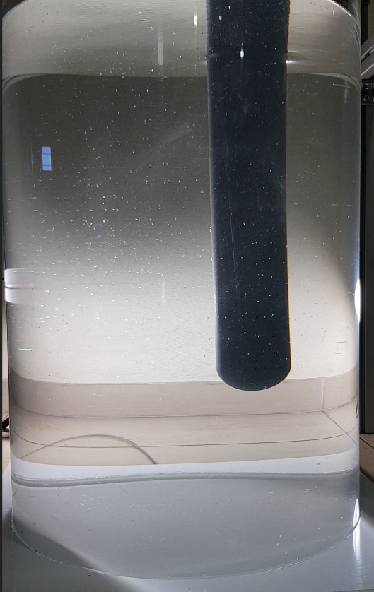
Ultrasonic Device for Melt Treatment
3. Trials
t = 0 sec
t = 60 sec
2021 ® MP Interconsulting || Marais 36, 2400 Le Locle, Switzerland ||www.UltrasonicsWorldGroup.com || mpi@mpi-ultrasonics.com

Slide 9
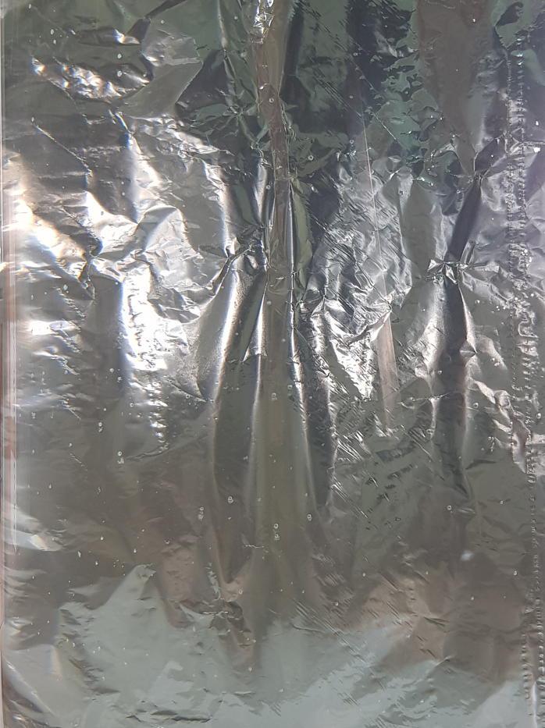
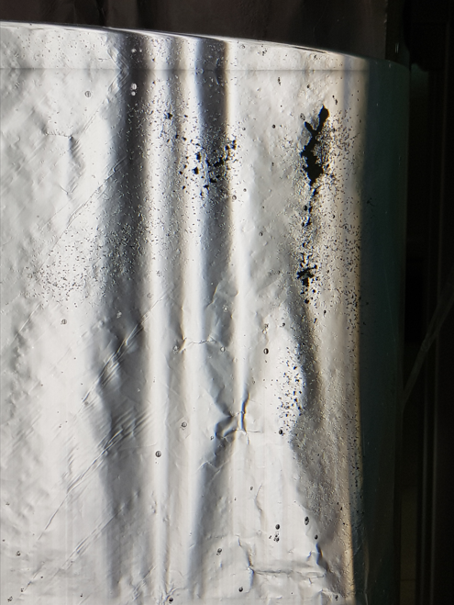
Ultrasonic Device for Melt Treatment
3. Trials
t = 0 sec
t = 60 sec
2021 ® MP Interconsulting || Marais 36, 2400 Le Locle, Switzerland ||www.UltrasonicsWorldGroup.com || mpi@mpi-ultrasonics.com

Slide 10
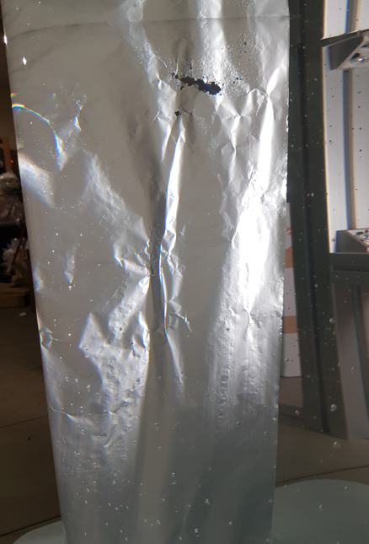
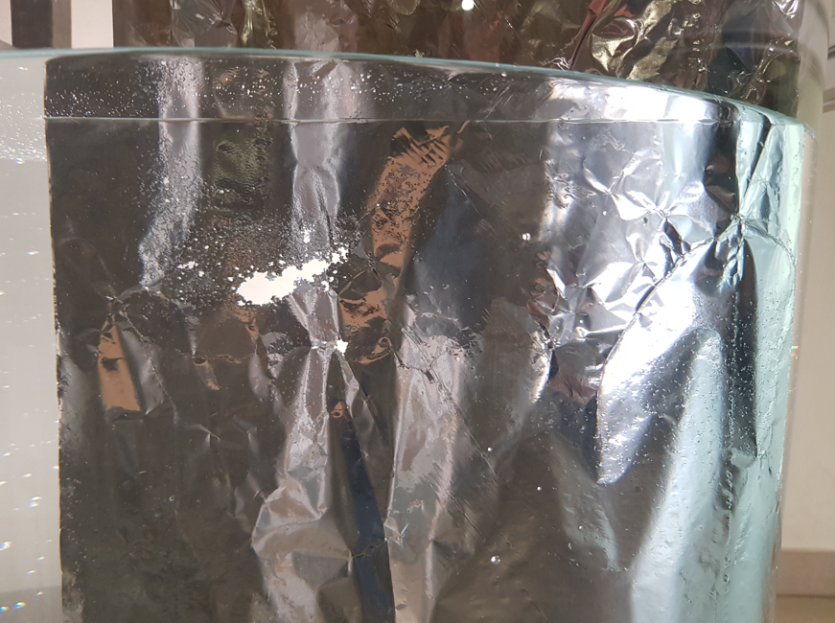
Ultrasonic Device for Melt Treatment
3. Trials
t = 60 sec
2021 ® MP Interconsulting || Marais 36, 2400 Le Locle, Switzerland ||www.UltrasonicsWorldGroup.com || mpi@mpi-ultrasonics.com

Slide 11
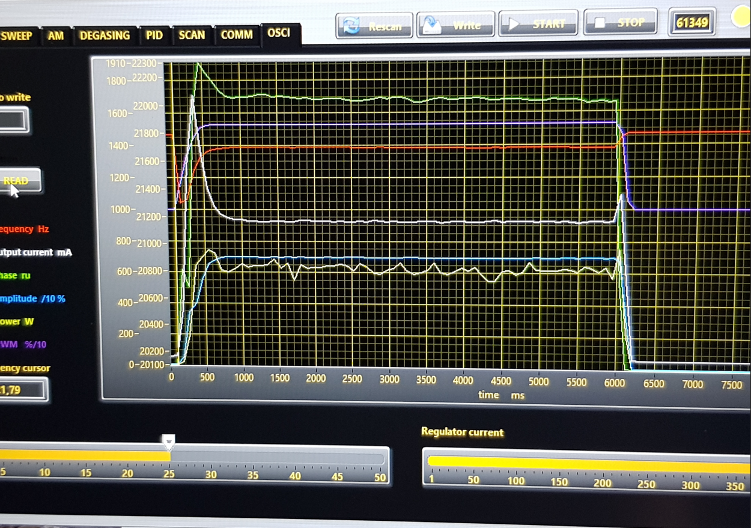
Ultrasonic Device for Melt Treatment
3. Trials
frequency
power
2021 ® MP Interconsulting || Marais 36, 2400 Le Locle, Switzerland ||www.UltrasonicsWorldGroup.com || mpi@mpi-ultrasonics.com

